Slide 1
ANJUMAN COLLEGE OF ENGG. & TECH. DEPARTMENT OF SCIENCE & HUMANIIES APPLIED MATHEMATICS- I UNIT –III MATRICES
INVERSE OF A MATRIX BY ADJOINT METHOD:
Let A be a square matrix and 𝖨 A 𝖨 ≠ 0 i.e. A is non singular matrix ,then inverse of a matrix by Adjoint method is given by = (adjoint of matrix A)
Where
adjoint of matrix A = transpose of [cofactor of matrix A]

Slide 2
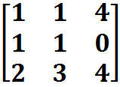
W K T [ADJOINT OF MATRIX A]=
Question 1: Find inverse of matrix A by adjoint mathod
Given A=
Solution :
Given A=
𝖨 A 𝖨 =4 ≠ 0

Slide 3
𝖨 A 𝖨 = - 231 ≠ 0
WKT By adjoint method
Question 2: By adjoint method find
Solution : Given

Slide 4
Question 3: By adjoint method find Given
[ cofactor of matrix A ]=
=
WKT By adjoint method we have
[Adjoint of A]=

Slide 5
WKT By adjoint method we have
Solution : Given
𝖨 A 𝖨 = 7 ≠ 0
exists
[ cofactor of matrix A ]=
[Adjoint of A]= =

Slide 6
Solution: Given system of equation in a matrix form is
Solution of Simultaneous Equation
By Adjoint Method :
Question 1: Using Adjoint Method solve
x + 2y + z =7
x + 3z =11
2x – 3y =1

Slide 7
[ cofactor of matrix A ]=
i.e. A X=B
X= B ------------(1)
To find by adjoint method
We have A=
𝖨 A 𝖨 = 18 ≠ 0
exist

Slide 8
[Adjoint of A] =
=
WKT By adjoint method we have
Substituting the value of & B in equation (1) we get
X= B

Slide 9
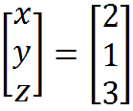
Question 2: Solve the system of equation by matrix method 2x + 3y + 4z =15 3x - y + 2 z = 9 , x + y + z = 5
x=2
y=1
z=3
are the solution of given equations

Slide 10
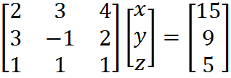
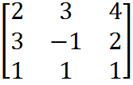
𝖨 A 𝖨 = 7 ≠ 0 exist
Solution:
Given system of equation in a matrix form is
i.e. A X=B
X= B ------------(1)
To find by adjoint method
We have A=

Slide 11
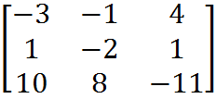
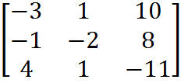
[cofactor of A] =
[Adjoint of A] =
=
WKT By adjoint method we have

Slide 12
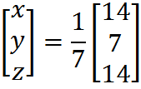
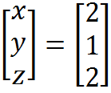
x=2 ,y=1, z= 2 are the solution of given equation .
Substituting the value of & B in equation (1) we get
X= B

Slide 13
Question 5: Using adjoint method solve 5x + 3y + 3z = 48 2x + 6y - 3z = 18 8x - 3y + 2z = 21
H.W
Question 3: Using Adjoint Method solve
x + y + z = 3
x + 2y + 3z = 4
x + 4y +9z = 6
Question 4: Solve By Matrix Method
3x + y + 2z = 3
2x - 3y - z = -3
x + 2y + z = 4

Slide 14
*********
Thank you

